Slide 1
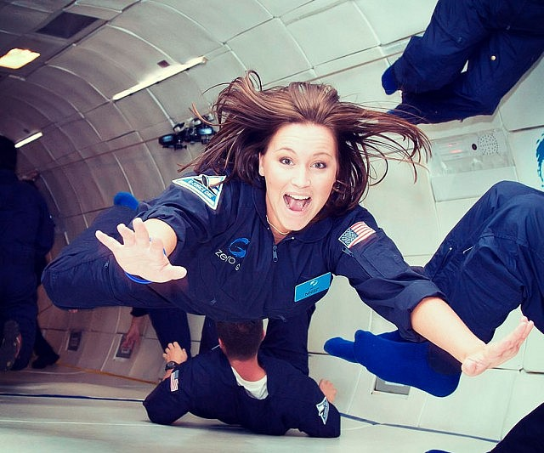
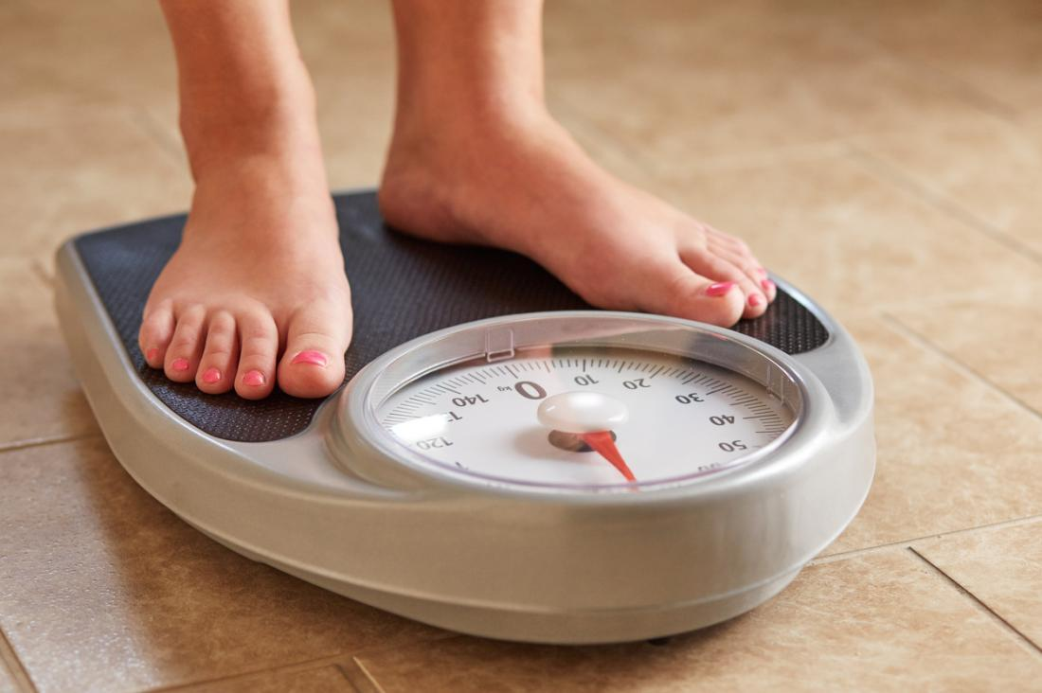

1.1 Newton’s Law of Gravitation PART 2 – Apparent Weight

Slide 2

Apparent weight and
Changes in apparent weight due to vertical acceleration

Slide 3
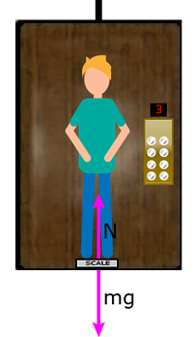
Perception of Weight
Our weight is a force which pushes down on other objects.
Because our weight force does not actually push on us directly, we do not actually feel that force.
What we do feel is the reaction of the other objects (e.g. ground) pushing back on us. (Newton’s 3rd Law).
This force is what we perceive as our apparent weight.
If we are not accelerating, then NET force must be equal to ZERO. (Newton’s 1st Law)
This means that the reaction force (or “normal” force) from the ground onto us must be the same as our weight force.
Thus our apparent weight is equal to our actual weight.

Slide 4
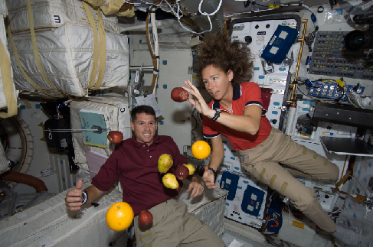
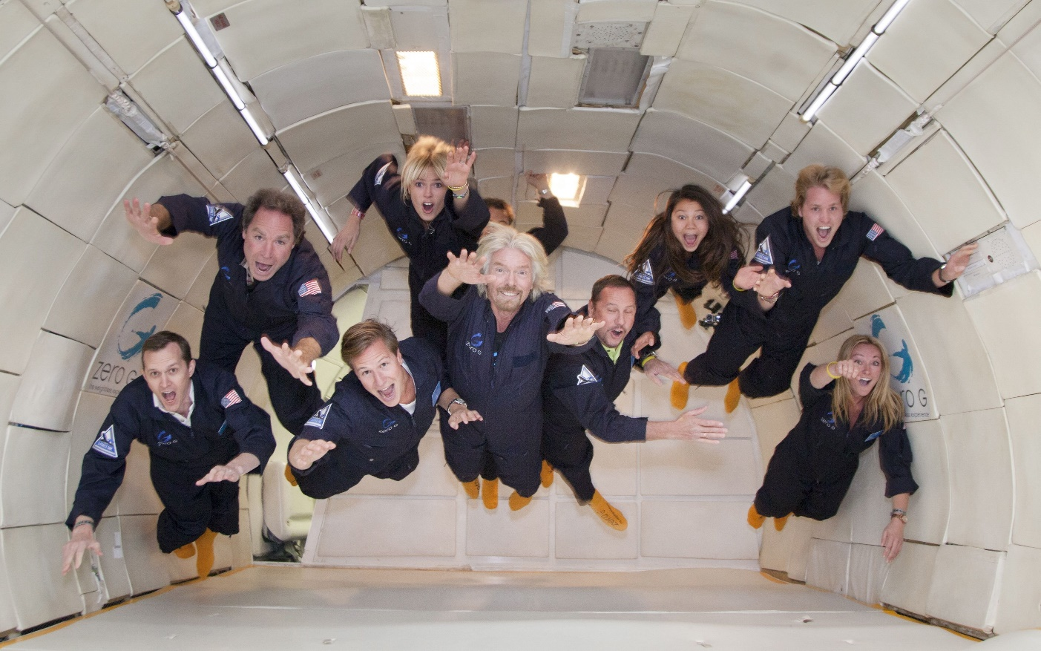
I can haz weightless?
These astronauts are on the international space station. It orbits at an altitude of 400 km.
Use Newtons Law of Gravitation to calculate the value for the gravitational field strength on the ISS.
Sir Richard Branson and his crew are not actually in space in this picture. They are in a jet aeroplane. So why does it appear that they are weightless?

Slide 5
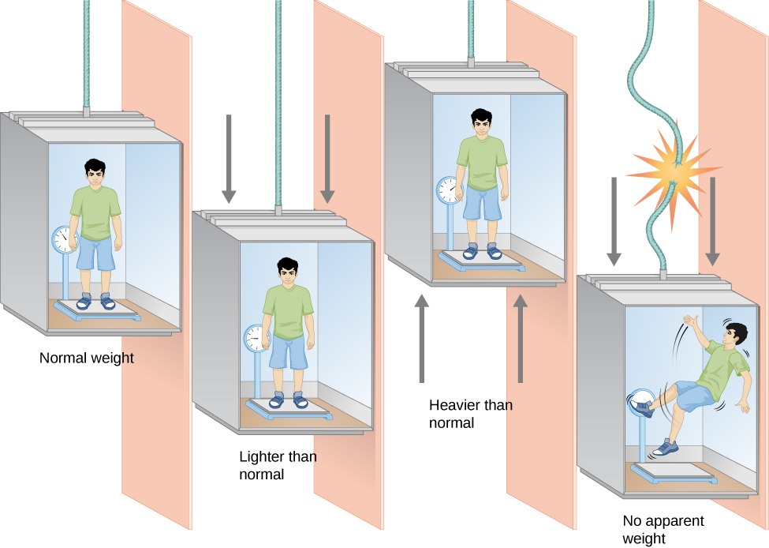
Apparent Weight and Acceleration
At REST
or
Uniform velocity
As described earlier, a person in a lift at rest or moving with a constant velocity has a net force of zero on them. (Newtons first law).
This means the Normal force is equal to the Weight force
Thus the persons apparent weight (F_{N}) is equal to their actual weight. (F_{W})
F_{N}
F_{W}
F_{N}
+
F_{W}
= 0

Slide 6
Apparent Weight and Acceleration
Accelerating upwards
If the lift is accelerating upwards, there must be an upward net force on them. (Newtons second law).
This means the Normal force must be greater than the Weight force
Thus the persons apparent weight (F_{N}) is greater than their actual weight. (F_{W})
F_{N}
F_{W}
𝛴 F
F_{N}
+
F_{W}
=

Slide 7
Apparent Weight and Acceleration
Accelerating downwards
If the lift is accelerating downwards, there must be a downward net force on them. (Newtons second law).
This means the Normal force must be less than the Weight force
Thus the persons apparent weight (F_{N}) is less than their actual weight. (F_{W})
F_{N}
F_{W}
F_{N}
+
F_{W}
=
𝛴 F

Slide 8
Apparent Weight and Acceleration
Free Fall
If the lift cable snaps, the person will be in free fall falling at the same rate as the elevator.
The lift will not push on them, and their weight will be the only force on them, thus net force is equal to Weight force
This means the Normal force will be equal to zero.
Thus the persons apparent weight (F_{N}) is ZERO!
This is apparent weightlessness.
0 +
F_{W}
=
F_{N}
𝛴 F
F_{W}

Slide 9
Testing your understanding
A 50 kg mass is put onto a scale in an elevator moving at constant velocity. In which elevator will the scale have the greatest reading?
B.
v = 2 m/s
A.
C.
D. The scale will have the same reading in all three elevators
50
50
50
v = 0 m/s
v = 2 m/s

Slide 10
Testing your understanding
A 50 kg mass is put onto a scale in an elevator. In which elevator will the scale have the greatest reading?
a = 2 m/s²
The scale will have the same reading in all three elevators
Cannot determine without initial velocities
A.
B.
C.
50
50
50
a = 0 m/s²
a = -2 m/s²

Slide 11
Testing your understanding
Rank the elevators from the largest scale reading to the smallest scale reading. In this question, down is negative..
1.
2.
3.
4.
5.
50
50
50
50
50
v = 0 m/s
a = 0 m/s²
v = 10 m/s
a = -2 m/s²
v = 2 m/s
a = 2 m/s²
v = -2 m/s
a = -5 m/s²
v = -10 m/s
a = 5 m/s²
5 → 3 → 1 → 2 → 4

Slide 12
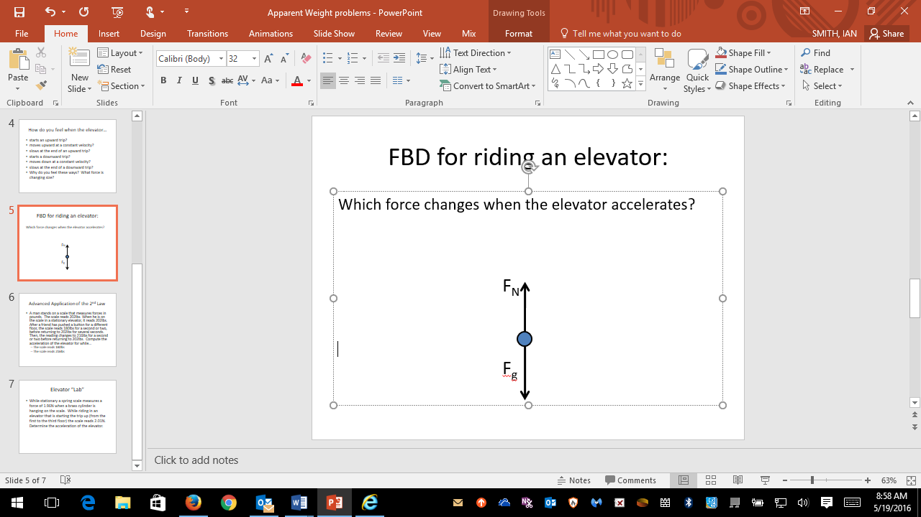
Practice Problems and Calculations
Construct the Free body diagram for a person in an elevator:
Will the normal force always balance the gravitational force? Explain.
“Expand” Newton’s Second Law (𝛴F=ma) based on the FBD you made. Remember that up is the positive direction!
NO – NOT IF THE ELEVATOR IS ACCELERATING!
ΣF = ma becomes F_{N} – F_{g} = ma

Slide 13
Practice Calculations
Determine the person’s apparent weight or how heavy they feel (the size of the normal force on them) in each of the following situations:
A 50kg person in an elevator that is accelerating downward at a rate of 0.75 ms⁻²
A 50 kg person riding an elevator that is moving down at a constant 1.5 ms⁻¹.
A 50kg person riding an elevator that is accelerating upward at 2.0 ms⁻².
A 100kg person rides in an elevator that is moving up and gaining 1.5 ms⁻¹ each second.
A 100 kg person riding in an elevator that is moving upward at a constant 3.0 ms⁻¹.
A 100kg person riding an elevator that is moving upward but slowing by 0.5 ms⁻¹ each second.

Slide 14
Practice Calculations
Determine the person’s apparent weight or how heavy they feel (the size of the normal force on them) in each of the following situations:
A 50kg person in an elevator that is accelerating downward at a rate of 0.75m/s/s. 452.5N
A 50 kg person riding an elevator that is moving down at a constant 1.5m/s. 490N
A 50kg person riding an elevator that is accelerating upward at 2.0m/s/s. 590N
A 100kg person rides in an elevator that is moving up and gaining 1.5m/s each second. 1130N
A 100 kg person riding in an elevator that is moving upward at a constant 3.0m/s. 980N
A 100kg person riding an elevator that is moving upward, but slowing by 0.5m/s each second. 930N

